Slide 1
2 - Privacy
MPU33213
Computer Ethics and Professional Responsibility
Oct 2017

Slide 2
Topics covered
Privacy Risks and Principles
The Business and Social Sectors
Protecting Privacy: Technology and Markets
Protecting Privacy: Rights and Laws
Privacy legislation in Malaysia
MPU33213-SE-Oct2016

Slide 3
Privacy issues
3 key aspects
  Freedom from intrusion
  Control of information about oneself
  Freedom from surveillance
Argument against
  Support deception, fraud
Argument for
  Personal issues should be private
  Privacy is necessary for security
MPU33213-SE-Oct2016

Slide 4
Can we have 100% privacy ?
Have to divulge personal information to varying extents in order to interact with society
Control of information about oneself means control of what is in other people’s minds !
MPU33213-SE-Oct2016

Slide 5
Privacy threats
Intentional, institutional uses of personal information
Unauthorized use or release by “insiders,”
Inadvertent leakage
Theft of information
Actions of end users
MPU33213-SE-Oct2016

Slide 6
Privacy risks from technology
Personal information on blogs and social networks
Genealogy sites include security-sensitive information
Software that tracks our activity on the Web
Archive of our communications on text, email, and social networks
MPU33213-SE-Oct2016

Slide 7
Privacy risks from technology
GPS on mobile devices allow tracking of our location and movements
Cellphones can be used to record events
Surveillance tools from law enforcement agencies
User profiling from video, email, social network etc
MPU33213-SE-Oct2016

Slide 8
Search query data
Archive all search phrases
  Analysis purposes
  Input for testing improvement in ranking results
  Valuable to a lot of other companies for business
MPU33213-SE-Oct2016

Slide 9
Smart phones
Location data is meant to be anonymous
  In some cases, included phone ID, age, gender information
Flaw or intentional design in apps
  Copying or storing of personal information
MPU33213-SE-Oct2016

Slide 10
Stolen and lost data
Criminals steal personal data
  cellphone records, credit reports, credit card statements, medical and work records,
Accidental loss
Sensitive data posted publicly
MPU33213-SE-Oct2016

Slide 11
Principles for managing personal data
personal information
  any information relating to, or traceable to, an individual person.
Informed consent
  informs people about the kind of data collected as well as its data collection and use policies.
MPU33213-SE-Oct2016

Slide 12
Invisible information gathering
Spyware
  track someone’s Web surfing
  collect passwords and credit card numbers
Cookies
  usually to help provide personalized customer service and target advertising
MPU33213-SE-Oct2016

Slide 13
Secondary use
use of personal information
  for a purpose other than the original
Data mining
  Analyzing masses of data to find patterns
Matching
  combining and comparing information from different databases
Profiling
  analyzing data to determine characteristics of people engaging in certain behavior
MPU33213-SE-Oct2016

Slide 14
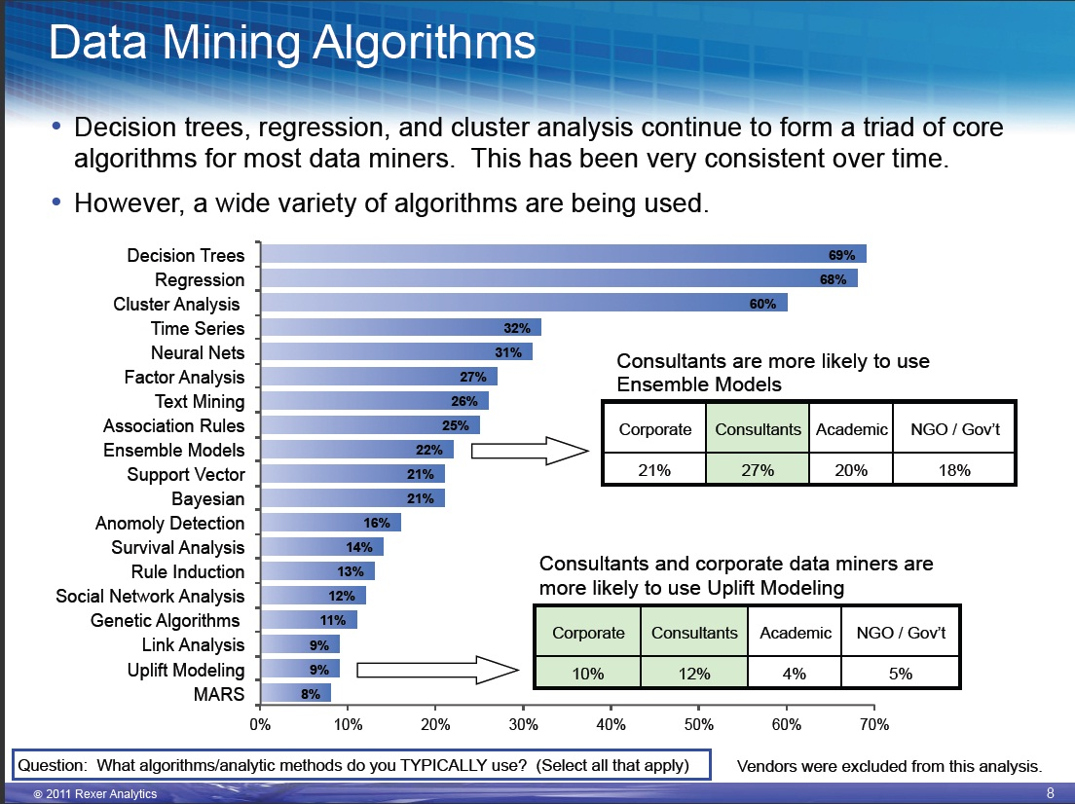
UECS3313-SE-Oct2016

Slide 15
Opt in and opt out
Opt-out policy
  one must do something to request that one’s personal information is NOT used
Opt-in policy
  One must do something to request that one’s personal information is used
MPU33213-SE-Oct2016

Slide 16
Fair information principles
Have informed consent
Offer opt out features
Collect only data needed
Keep data only as long as needed
Maintain accuracy of data
Protect security of data
Develop policies for responding to law enforcement requests
MPU33213-SE-Oct2016

Slide 17
Marketing and personalization
Businesses store and analyze data
  How to attract new customer and how to retain old customer
  Target ads based on prior purchases and buying patterns
Argument against:
  No control of information about oneself
Argument for:
  Targeted marketing reduces overhead and costs of products
MPU33213-SE-Oct2016

Slide 18
Ethical concerns
Informed consent
  Complexity makes consent unclear
  User has no idea about secondary uses
Issues
  Is it the user’s responsibility to be aware ?
  Does a person’s decision to interact constitute implicit consent ?
  How clear, obvious, and specific ?
  How to protect people who do not understand while allowing for other people who understand ?
MPU33213-SE-Oct2016

Slide 19
Paying for consumer information
Renumeration of customers for use of their information
Argument against:
  the attraction of free services may coerce poor / uneducated into giving up their privacy
Argument for:
  Large uptake means most people don’t care
MPU33213-SE-Oct2016

Slide 20
Using social networks
Our own responsibility
  our own opinions on Facebook, Twitter, etc
  Safety of others using location-based services (Swarm)
Responsibilities of the companies (e.g. Facebook)
  News feeds, tagging as opt-out
  Beacon ad program tracking on external sites
  Retaining access to personal data after account deletion
MPU33213-SE-Oct2016

Slide 21
Right to be forgotten
Remove information about themselves
  Tweet, Facebook profile, web profile, etc
Issues:
  Removing material that is not in user’s account (freedom of speech) ?
  Removing user data breaks legal agreement and removes compensation
  Deletion request to hide illegal behaviour
  Legal requirement to remove
MPU33213-SE-Oct2016

Slide 22
Communications
Intercepting communications is common:
  Law enforcement and intelligence agencies
Argument for:
  Necessary to combat crime
Argument against:
  Monitoring of people with unconventional political views, civil rights groups, etc
MPU33213-SE-Oct2016

Slide 23
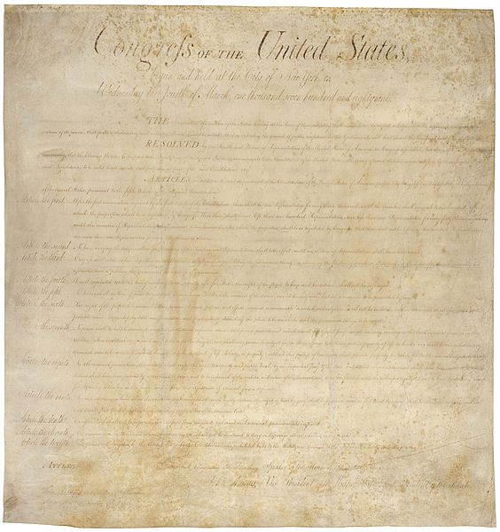
United States (Bill of rights)
MPU33213-SE-Oct2016

Slide 24
4th amendment
The right of the people to be secure in their persons, houses, papers, and effects, against unreasonable searches and seizures, shall not be violated, and no Warrants shall issue, but upon probable cause, supported by Oath or affirmation, and particularly describing the place to be searched, and the persons or things to be seized.
MPU33213-SE-Oct2016

Slide 25
Relevant US laws
The 1934 Communications Act
1968 Omnibus Crime Control and Safe Streets Act
Electronic Communications Privacy Act of 1986 (ECPA)
1994 Communications Assistance for Law Enforcement Act (CALEA)
USA PATRIOT ACT 2001
MPU33213-SE-Oct2016

Slide 26
General criticisms
threats to privacy and civil liberties
potential for abuse by government for non-valid purposes (political)
the side effects of “backdoor” access threaten the security of the entire communications systems.
tapping communications is not as useful as informants, detective work, witnesses, and so on.
MPU33213-SE-Oct2016

Slide 27
National Security Agency
Uses methods that do not satisfy 4th amendment
  Subject to Foreign Intelligence Surveillance Court regulation (FISC)
Operate secret monitoring rooms at major US telecommunications facilities
  Do sophisticated data mining on info of millions of Americans and foreigners
MPU33213-SE-Oct2016

Slide 28
National Security Agency leak disclosure 2013
Leaked by Edward Snowden
  Very controversial in the US and worldwide
  Scale of interception
  Espionage against governments all over the world
  Collects data from major communications companies
  Many members of Congress are not aware and the FISC cannot act against the NSA
MPU33213-SE-Oct2016

Slide 29
Technology and markets
Privacy-protecting software
Companies build technology-based privacy protections
Businesses respond to consumer demands and improve policies and services
Organizations (PRC, EPIC) inform the public, file lawsuits, and advocate for better privacy
MPU33213-SE-Oct2016

Slide 30
Encryption
Transforms human-readable data (plaintext) into an encrypted form (ciphertext)
  Mainly sensitive data
  cryptographic algorithm and a specific sequences of characters (e.g., digits or letters), called a key
  Most of the time automatically done by software (browser)
MPU33213-SE-Oct2016

Slide 31
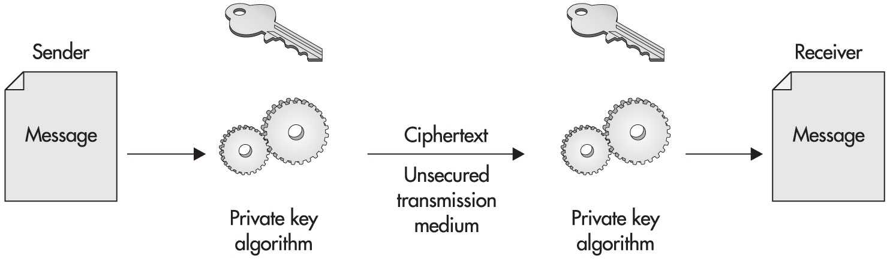
Private key encryption
Key sequence: 1001110110
Key sequence: 1001110110
“Hello World”
“Hello World”
£”$%^$Fg@3
MPU33213-SE-Oct2016

Slide 32
US Govt and encryption
attempted to enforce a policy of prohibiting export of powerful encryption software
  to keep strong encryption from terrorists and enemy governments
  Court overturned on First Amendment -> computer programs are speech
Attempted to ensure access to encryption keys or loophole in encryption products
  target Criminals and child molesters
  Backdoor would weaken all e-commerce
MPU33213-SE-Oct2016

Slide 33
Approaches to protecting personal data
Continually updating security policies
Provide training for employees
Design proper authorization and access schemes
Implement audit trails in the computer system
Use of trusted third parties to process confidential data
Do privacy audits, have chief privacy officer
Use economic influence
MPU33213-SE-Oct2016

Slide 34
Evolution of legal protection
Original court decisions based on other rights
  libel, defamation, copyright infringement, property rights, breach of contract
  Change to consider the right to privacy is a right on its own
Consideration violation
  How it is being used
  How it was obtained
  Consent is key
MPU33213-SE-Oct2016

Slide 35
Violation of privacy
violation of privacy is the action of unauthorized publication of personal information
  permissible to disclose personal information from a database for a demonstrated valid use
right to privacy in a transaction that involves more than one person
  Who has control and how to determine ?
MPU33213-SE-Oct2016

Slide 36
Ownership of personal data
Give people property rights in information about themselves
  Activities and transactions often involve two or more people
  not make sense to assign ownership of some personal information
  ownership of facts would severe impair the flow of information
MPU33213-SE-Oct2016

Slide 37
Legal framework
If privacy policy exists
  protecting privacy is simply legal enforcement of a contract.
If NOT:
  special confidentiality defaults for sensitive information (medical and financial information)
Right level of penalties
  Not too strict and not too weak
MPU33213-SE-Oct2016

Slide 38
Free market view
prefers market-oriented solutions
  respects the right and ability of consumers to make choices
emphasizes informed consent.
  prefer penalties when a company loses, inappropriately discloses, or abuses the data
MPU33213-SE-Oct2016

Slide 39
Free market: opposing too much legislation
Regulation that is not well designed
  additional hidden or unexpected costs
Varying requirements of privacy
  Regulations determine in advance – unfair for everyone
Laws that prohibit contracts violate freedom of choice
MPU33213-SE-Oct2016

Slide 40
Consumer protection view
focus is to protect consumers against
  abuses and carelessness of the businesses
  consumer’s own lack of knowledge, judgment, or interest
  imbalance of power between the individual and a large corporation
Legal restrictions
  User profiling, prohibitions contracts, force companies to have opt-in policies
  See privacy as a claim right
MPU33213-SE-Oct2016

Slide 41
Personal Data Protection Act 2010 (Malaysia)
aimed at regulating the processing of the personal data of an individual
  Makes it a criminal offence for data users to reveal personal data to third-parties without the data owner’s consent or notification
  curb spam sms
MPU33213-SE-Oct2016

Slide 42
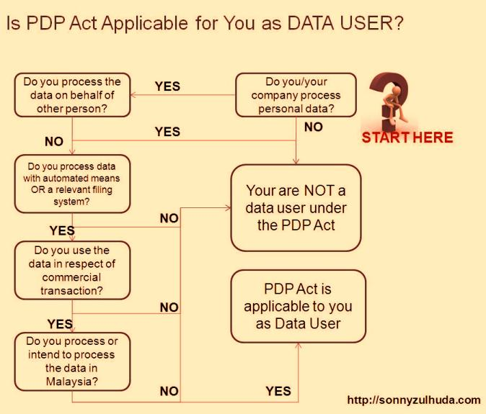
MPU33213-SE-Oct2016

Slide 43
Personal Data Protection Act 2010
applies to companies that are established in Malaysia
  All data users will need to register by end of 2013 (mandatory)
  banking and financial institutions, insurance, telecommunications, utilities, healthcare, hospitality and tourism, education …….
MPU33213-SE-Oct2016

Slide 44
Personal Data Protection Act 2010
What is personal data?
Do you process personal data?
Do you process personal data in Malaysia?
MPU33213-SE-Oct2016

Slide 45
Personal Data Protection Act 2010
General Principle
Notice and Choice Principle
Disclosure Principle
Security Principle
Retention Principle
Data Integrity Principle
Access Principle
MPU33213-SE-Oct2016

